Slide 1
Team 1 :
BOOK RECOMMENDATION SYSTEM
Team Members
Anjali Patil
Shivani Gavali
Akash Yadav
PRANJALEE SHARMA
RANJITH SAMUDRALA
POTTHULA SRIMAN
Bhagyashree Ambade

Slide 2
Content
Problem statement
Data Summary
Analysis of different datasets
Outlier Detection
Model Building
Model Evaluation
Conclusion
Challenges

Slide 3

Problem Statement
During the last few decades, with the rise of Youtube, Amazon, Netflix, and many other such web services, recommender systems have become much more important in our lives in terms of providing highly personalized and relevant content.
The main objective is to create a recommendation system to recommend relevant books to users based on popularity and user interests.

Slide 4
Data Summary
The dataset is comprised of three csv files:: User_df, Books_df, Ratings_df
Users_dataset.
User-ID (unique for each user)
Location (contains city, state and country separated by commas)
Age Shape of Dataset - (278785, 3)
Books_dataset.
ISBN (unique for each book)
Book-Title
Book-Author
Year-Of-Publication
Publisher
Image-URL-S
Image-URL-M
Image-URL-L
Shape of Dataset - (271360, 8)
Ratings_dataset.
User-ID
ISBN
Book-Rating
Shape of Dataset - (1149780, 3)

Slide 5
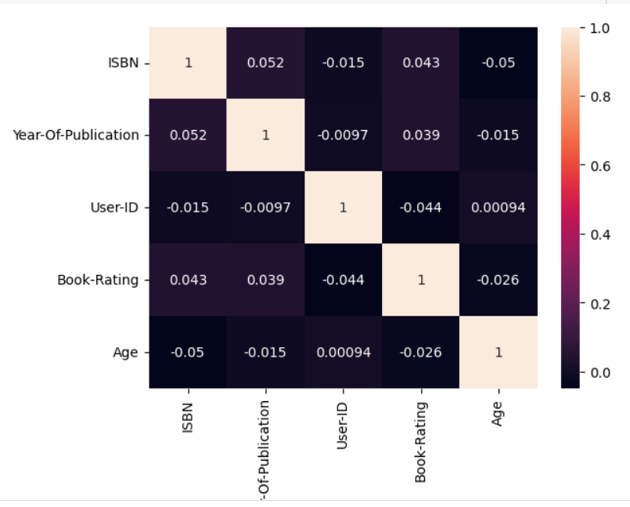
CORRELATION HEATMAP
The correlation heatmap visually represents the relationships between numerical variables within a dataset. Here are the key insights:
ISBN and Year-Of-Publication: These two variables exhibit a weak positive correlation (approximately 0.052).
User-ID and Book-Rating: There appears to be no significant linear relationship between user IDs and book ratings.
Age and Book-Rating: Similar to the previous case, there is no strong correlation between age and book ratings. Age alone does not predict book ratings.

Slide 6
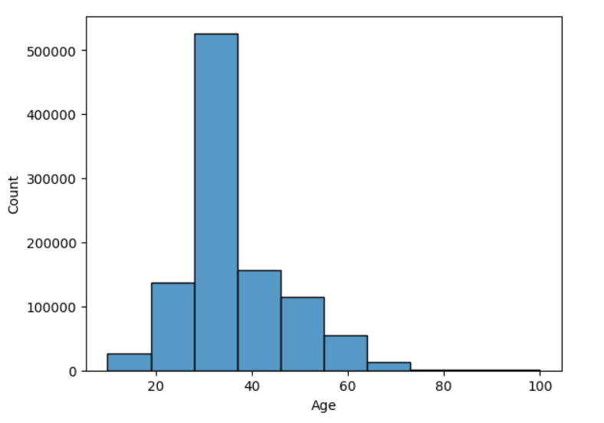
Observations from Users_df (Age)
The distribution of age within a dataset.
The histogram is right-skewed.
The highest frequency occurs around the 20-30 age range.
The dataset contains a larger proportion of young people compared to older age groups.

Slide 7
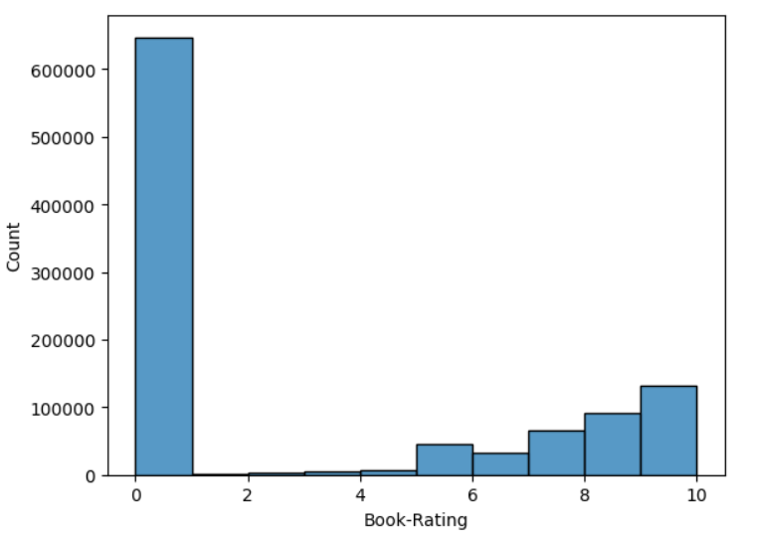
Observations from Ratings_df (Book-Rating)
The distribution of book ratings within a dataset
The histogram has a significant spike at the rating of “0”. This means that a large number of books have received a rating of zero.
As we move towards higher ratings (from 1 to 10), the bars become shorter, indicating fewer books with those ratings.

Slide 8
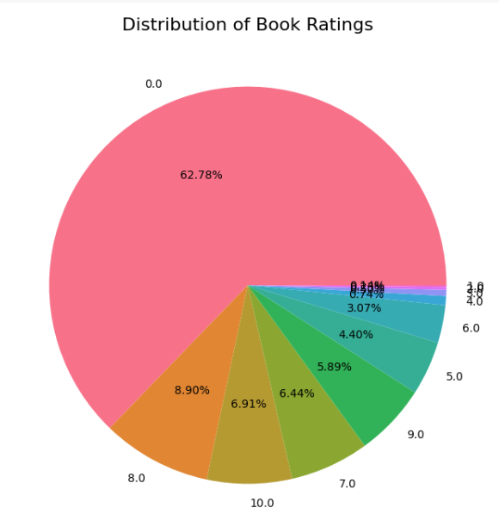
Observations from Ratings_df (Book-Rating)
The distribution of book ratings within a dataset using pie chart
The largest section in pink represents books with a rating of 0.0, accounting for 62.78% of the dataset.
8.0: The green slice corresponds to books rated 8.0, making up 6.91%.
9.0: The orange slice represents books rated 9.0, comprising 5.89%.
Ratings from 2.0 to 7.0: These smaller sections (in various colors) account for the remaining ratings.

Slide 9
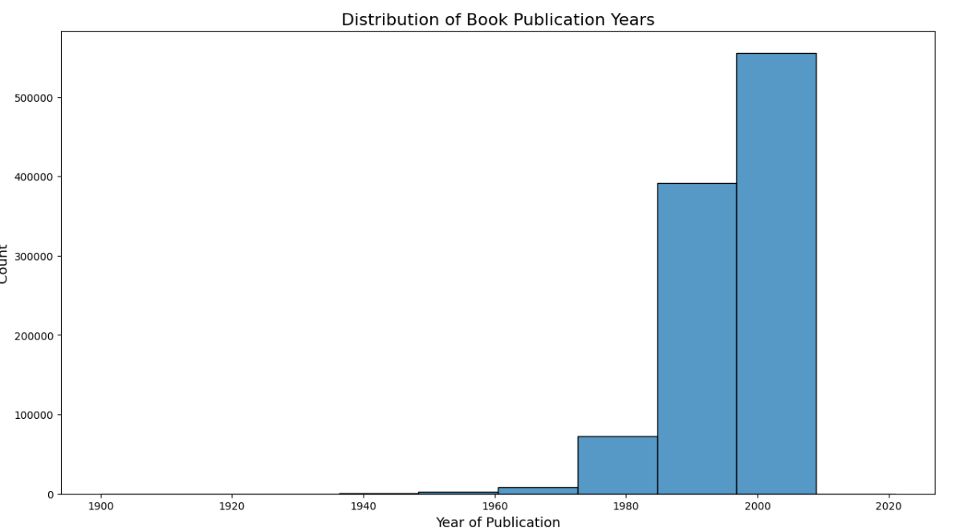
Observations from Books_df (Year of Publication)
The distribution of Book Publication Years within a dataset.
The histogram is right-skewed.
In this graph, the peak occurs between the years 2000 and 2020.This suggests that a significant number of books were published during this period.

Slide 10
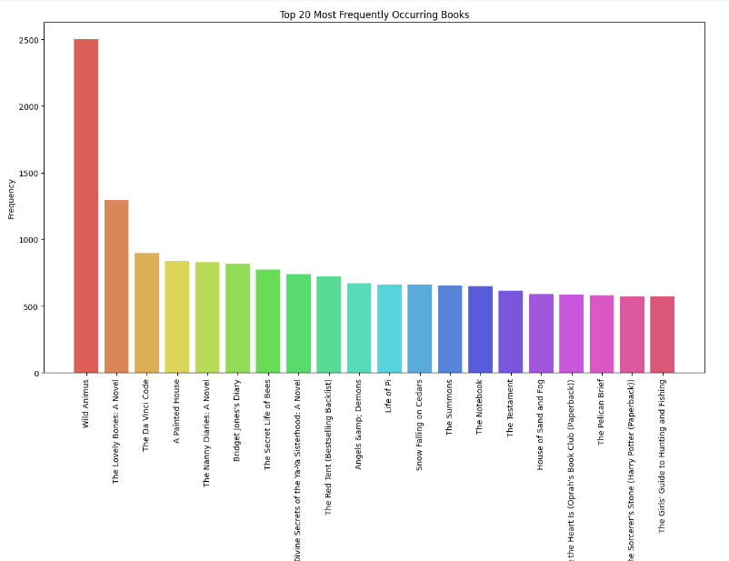
Observations from Book_df (Book title)
These books are significant within the dataset, and their high occurrence suggests their popularity or relevance.
Wild Animus occurs frequently

Slide 11
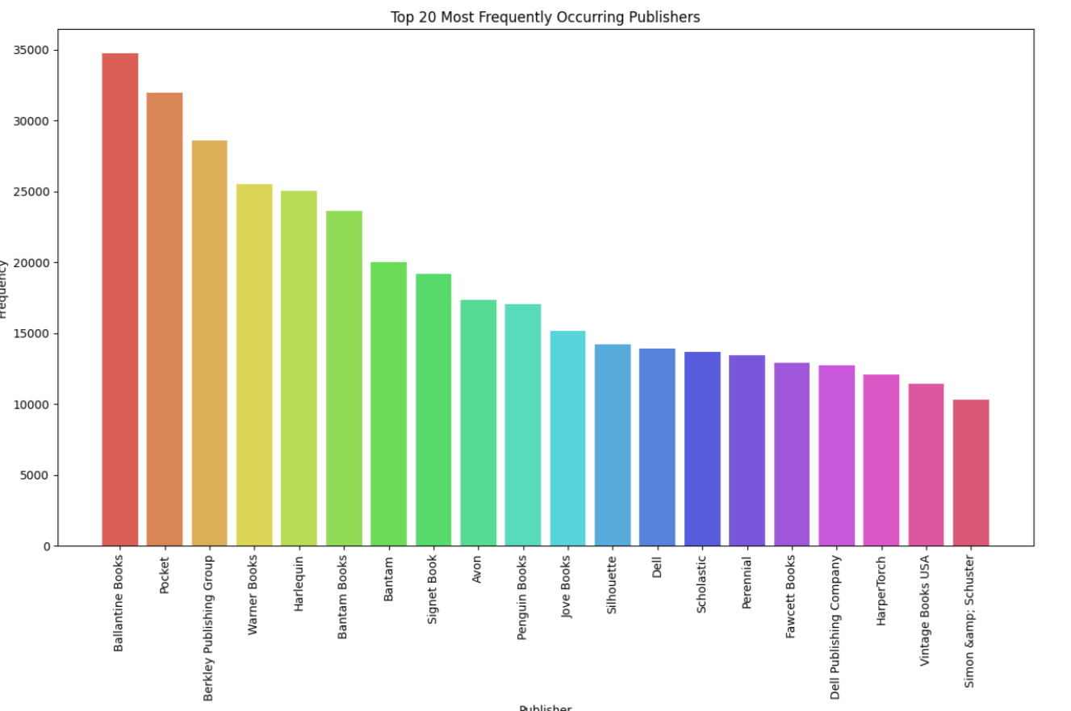
Observations from Book_df (Publishers)
Ballantine books published highest number of books in our given dataset

Slide 12
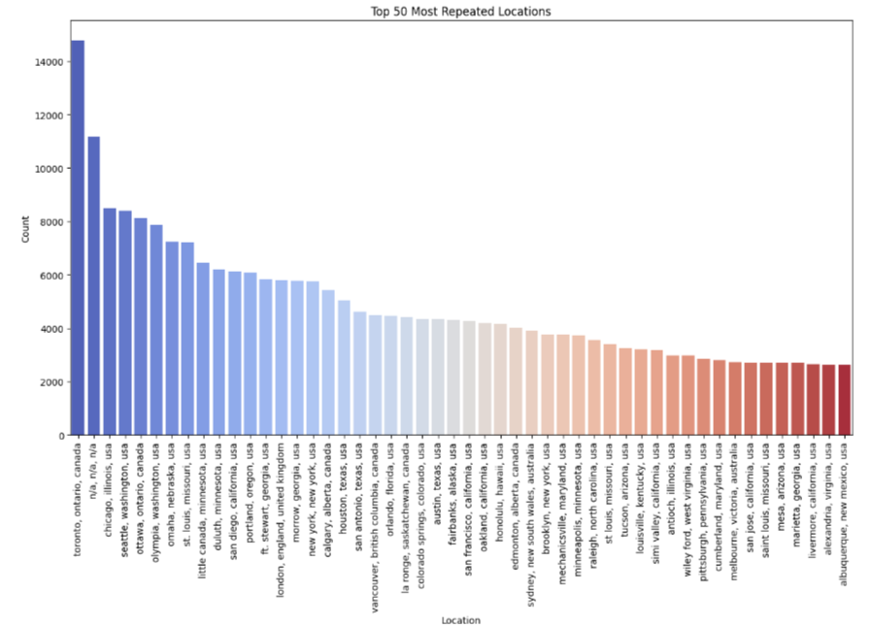
Observations from Users_df (Location)
Splitting Location column and analysing country.
Most active readers are from Canada.

Slide 13
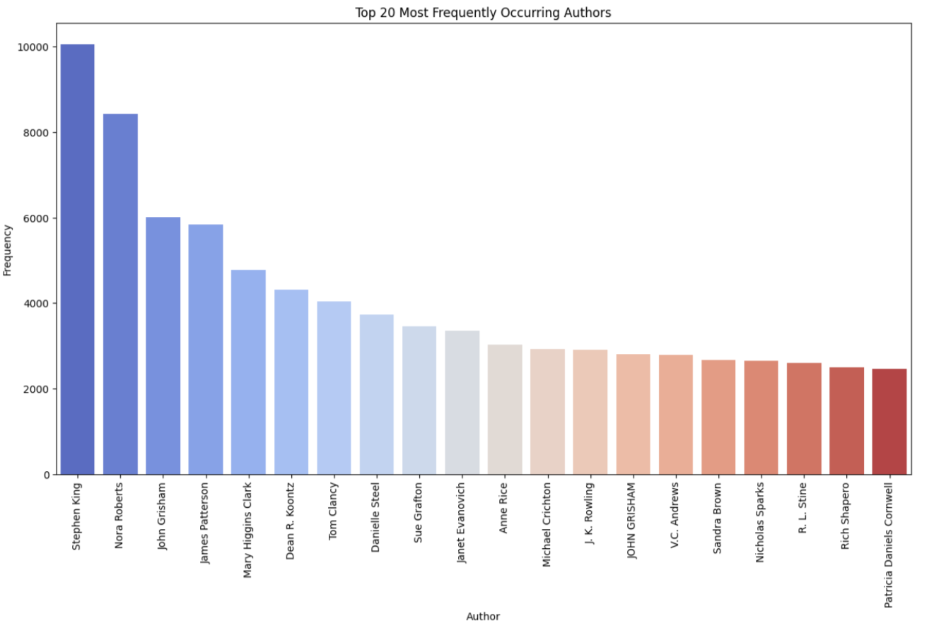
Observations from Book_df (Authors)
Stephen King wrote highest number of books in our given dataset

Slide 14
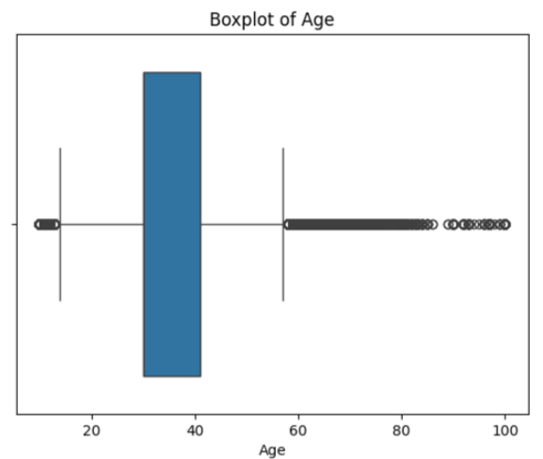
Outliers Detection
This boxplot visually represents the distribution of age within the dataset, highlighting the presence of outliers at higher ages.
The box represents the middle 50% of the data.
It spans from the first quartile (Q1) to the third quartile (Q3).
The median (middle value) is indicated by the line inside the box
The whiskers extend from the box to show the range of data outside the IQR.
On one side, it extends towards approximately age 20.
On the other side, it extends towards age 80.
The individual points beyond the whiskers are outliers.
These are ages that fall outside what would be considered normal variation.
In this case, the outliers cluster around age 100.

Slide 15
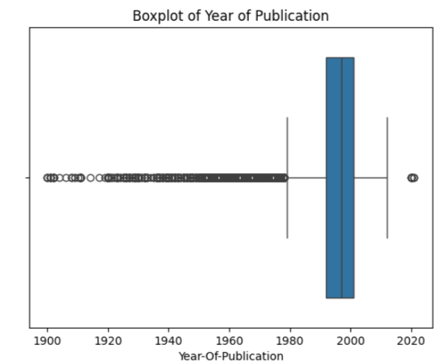
Outliers Detection
This boxplot visually represents the distribution of Year-of –Publication within the dataset.
The box represents the middle 50% of the data.
It spans from the first quartile (Q1) to the third quartile (Q3).
The median (middle value) is indicated by the line inside the box
The whiskers extend from the box to show the range of data outside the IQR.
The majority of publications occurred after 1960, as indicated by the position of the box.
The median year of publication is close to the year 2000, as indicated by the line within the box.
There is a significant number of outliers on both sides, but particularly for earlier years (left side), which suggests that there are some publications from much earlier years.

Slide 16
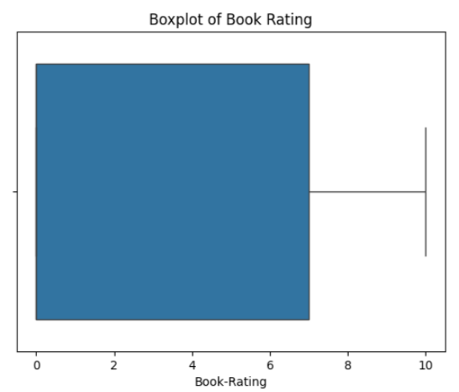
Outliers Detection
This boxplot visually summarizes the distribution of book ratings, indicating central tendency and variability without any specific outliers.
The box represents the middle 50% of the data.
It spans from the first quartile (Q1) to the third quartile (Q3).
The median (middle value) is indicated by the line inside the box
The whiskers extend from the box to show the range of data outside the IQR.
On one side, it extends towards approximately rating 2.
On the other side, it extends towards rating 10.
There are no individual points plotted beyond the whiskers.
This suggests that there are no outliers in this dataset for book ratings.
All data points fall within the typical range.

Slide 17
Model Building
1.) COLLABORATIVE RECOMMENDATION SYSTEM
1.SUGGETION OF BOOK_TITLE BASED ON THE USER_ID
Book Title: Pigs in Heaven
Book Title: The Testament
Book Title: Wild Animus
Book Title: Wild Animus
Book Title: Liberty Falling (Anna Pigeon Mysteries (Paperback))
2.NAME OF THE AUTHERS FOR THE ABOVE SUGGETION BOOK_TITLES
Book Title: Pigs in Heaven Author: Barbara Kingsolver
Book Title: The Testament Author: John Grisham
Book Title: Wild Animus Author: Rich Shapero
Book Title: Wild Animus Author: Rich Shapero
Book Title: Liberty Falling (Anna Pigeon Mysteries (Paperback)) Author: Nevada Barr
3.USER_ID'S WITH SIMILAR CHOICE IN READING:
Similar users for user 11676: [30735, 124487, 210959, 24194, 159376]
4.COMMON RECOMMENDATION FOR THE TWO USER_ID’S
Enter the first user ID: 11676
Enter the second user ID: 210959
Common book recommendations for users 11676 and 210959:
Ship of Fools: nan
Fight Club: nan
The Lost World: nan
The Keep: nan
The Street Lawyer: na

Slide 18
Model Building
2. CONTENT BASED RECOMMENDATION SYSTEM
Number of recommended books for user 2 : 6
Recommended books:
1 . Who's Who in Classical Mythology (Who's Who Series)
2 . Dictionary of Mythology: Mainly Classical
3 . Classical mythology
4 . The Dictionary of Classical Mythology
5 . Classical Mythology
6 . Mythology and You : Classical Mythology and its Relevance in Today's World

Slide 19
Model Building
3. Popularity Based Recommendation System
Top 5 popular book recommendations for user 210959:
The Demonic Comedy: Some Detours in the Baghdad of Saddam Hussein
Slaughtermatic
Elect Mr. Robinson for a Better World
Conspiracies, Cover-Ups and Crimes
South of Heaven (Vintage Crime/Black Lizard)

Slide 20
Model Evaluation
BASED ON COVERAGE OF TOP N-RECOMMENDATIONS
Coverage of Collaborative Filtering: 0.0
Coverage of Content-Based Filtering: 0.0
Coverage of Popularity-Based Filtering: 1.0
Best Recommendation System: Popularity-Based Filtering
2. BASED ON THE F1-SCORE
Collaborative Filtering:
Precision: 1.0 ; Recall: 1.0 ; F1-score: 1.0
Content-Based Filtering:
Precision: 0.8 ; Recall: 0.6666666666666666 ; F1-score: 0.7272727272727272
Popularity-Based Filtering:
Precision: 1.0 ; Recall: 0.8333333333333334 ; F1-score: 0.9090909090909091
Best Recommendation System based on F1-score: Collaborative Filtering

Slide 21
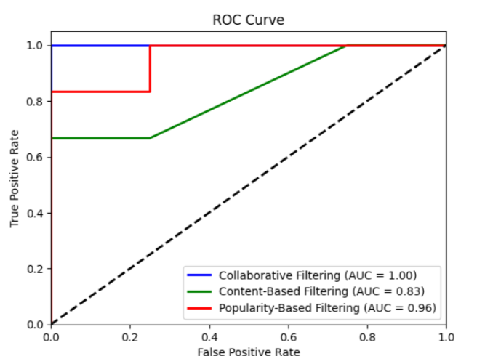
Model Evaluation
3. ON BASIS OF THE ROC-CURVE
Best Recommendation System based on AUC-ROC: Collaborative Filtering
On basis of the f1-score and roc-curve we are getting the " collaborative-recommendation system" as the best model.
Therefore collaborative filtering recommendation system is the best model fitting

Slide 22
Conclusion
A recommendation system helps an organization to create loyal customers. The recommendation system today are very powerful that they can handle the new customer too who has visited the site for the first time. They recommend the products which are currently trending or highly rated and they can also recommend the products which bring maximum profitto the company.
A book recommendation system is a type of recommendation system where we have to recommend similar type of books to the reader based on his interest. The books recommendation system is used by online websites which provide ebooks like google playbooks, open library, good Read’s, etc.

Slide 23
Challenges
The problem was that most books didn't have a lot of user activity, so it was difficult to deal with missing or sparse data.
Understanding the metric for evaluation was a challenge as well.
Since the data consisted of text data, data cleaning was a major challenge in features like Location etc..
Decision making on missing value imputations and outlier treatment was quite
challenging as well.

Slide 24
Thank You

